Slide 1
Illinois Health Benefits Exchange Advisory Committee Meeting
June 14, 2024

Slide 2
Roll Call
Welcome by IL HBEAC Co-Chairs
  Housekeeping
  Approval of Minutes of March 25, 2024 meeting
  IL HBEAC Charter Statement
IL HBEAC Member Survey Results
Director’s Report
  Overview of Current Illinois Health Marketplace
  2024 Marketplace Milestones
Public Comment Period
Other Matters
Adjourn
Agenda

Slide 3
Approval of Minutes

Slide 4
IL HBEAC Charter Statement

Slide 5
Illinois Health Benefits Exchange Advisory Committee Charter
The purpose of the Illinois Health Benefits Exchange Advisory Committee is to provide independent subject matter expertise and counsel to the Marketplace Director to ensure the effective and efficient establishment and operation of the state-based marketplace, Get Covered Illinois. The Committee shall provide advice and recommendations, when appropriate, on the following:
Ensuring a smooth transition from the federal to a state-based platform by plan year 2026, including:
  Engaging stakeholders in the planning and implementation process;
  Mitigating loss of health insurance coverage for consumers during the transition from the federal platform to Get Covered Illinois;
  Providing input on the development and implementation of Get Covered Illinois' policies and procedures;
Reviewing and making recommendations on Get Covered Illinois' operational plans;
Monitoring Get Covered Illinois' progress in meeting its goals and objectives;
Identifying and addressing any challenges or barriers to Get Covered Illinois' success; and
Providing feedback to the Department of Insurance on Get Covered Illinois' performance.
HBEAC Charter Statement

Slide 6
IL HBEAC Member Survey Results

Slide 7
IL HBEAC Member Survey Feedback
The below chart shows the overall ranking of policy topics by HBEAC members. The top overall ranking was for eligibility and enrollment policies and procedures. Additionally, variance in response was calculated, which showed relative congruence with the top and bottom rankings, but more divergence with topics ranked towards the middle.

Slide 8
Director’s Report

Slide 9
Overview of Current Illinois Health Marketplace

Slide 10
Overview of 2024 Illinois On-Exchange Plans
Illinois has 12 issuers on the Illinois Individual Exchange for plan year 2024, an increase of 1 from plan year 2023.
One new issuer entered the Individual ACA market for plan year 2024, Aetna Life Insurance Company
SSM Health Plan has changed their name to Medica Central Health Plan for plan year 2024
Rating areas in plan year 2024 remain unchanged from plan year 2023

Slide 11
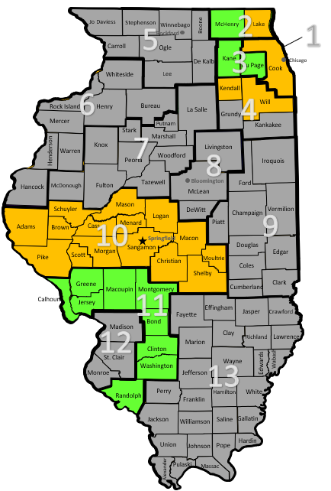
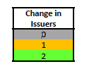
2024 Illinois Exchange Plan Analysis: Issuers
Residents in the Chicagoland area (Rating Areas 1, 2, 3, 4), parts of Central Illinois (Rating Area 10) and areas surrounding the St. Louis area (Rating Area 11) have an additional coverage option due to Aetna Life’s entrance into the market and Aetna Health, Celtic, Molina and Oscar’s expansions.
Much of the state saw little change in the number of issuers offering coverage relative to plan year 2023.

Slide 12
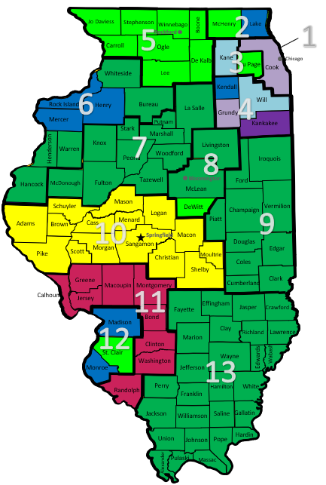
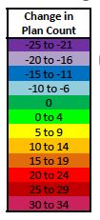
2024 Illinois Exchange Plan Analysis: Plans
The Chicagoland area experienced the largest decrease in plan options in Illinois in 2024, compared to 2023
Most of rural Illinois experienced little change in the total number of individual plans offered
Rating Area 11 experienced the largest increase in the number of plans being offered, partly driven by the expansion of Celtic in Rating Area 11 and Aetna Health into Rating Areas 10 and 11

Slide 13
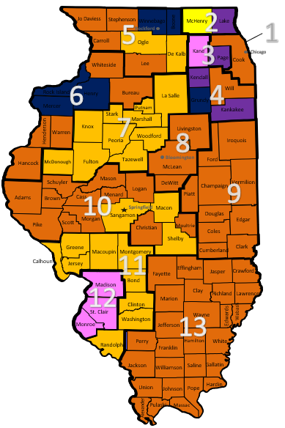
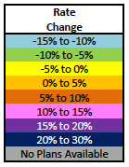
2024 Illinois Exchange Plan Analysis: Rates
Most of the state saw rate changes in the 0% to 10% range while the Chicagoland area, which makes up a large portion of the population, saw rate changes greater than 10% in some counties.
Parts of Rating Areas 4, 5 and 6 experienced the largest increases in rates.
McHenry County in Rating Area 2 saw a rate decrease for the lowest cost Bronze plan; however, the rest of the state saw rate increases to the lowest cost Bronze plan.
The distribution of issuers offering the lowest cost Bronze plan changed from 2023 to 2024. There is a wide variety of issuers who have the lowest cost bronze plan in at least 1 county:
  Aetna Health in all or part of two (2) rating areas
  Celtic in all or part of two (2) rating areas
  HAMP in all or part of four (4) rating areas
  HCSC in all or part of four (4) rating areas
  Oscar in all or part of one (1) rating area
  Quartz in all or part of one (1) rating area
  United in all or part of four (4) rating areas

Slide 14
Eligibility and Enrollment Statistics
Of the more than 500,000 individuals applying for coverage, 90% of them (or 457,408) were determined to be eligible for coverage. Of those individuals, 90% were determined eligible for financial assistance. Additionally, 30% of all marketplace plan selections were for new consumers.

Slide 15
Eligibility and Enrollment Statistics
Before any Advanced Premium Tax Credits (APTCs), the average premium was $676. After factoring in the tax credit (averaging $545), the new average premium dropped to $189. Roughly 90% of consumers were eligible for the APTC.

Slide 16
Eligibility and Enrollment Statistics
50% of all consumers (roughly 190,000 of 398,000) benefited from cost-sharing reduction (CSR). Below is a breakdown of CSR percentages.

Slide 17
Eligibility and Enrollment Statistics
Of all consumers, 92% were over the age of 18, 42% were white, 86% lived in a non-rural setting, and 51% were female.

Slide 18
Eligibility and Enrollment Statistics
Roughly one-third of all consumers fell within 100% and 150% of the FPL. 55% of consumers were silver level and 38% were bronze.

Slide 19
2024 Marketplace Milestones

Slide 20
Milestones and Timeline
March 2024
April 2024
May 2024
Marketplace Director onboarded
Inaugural HBEAC Meeting
Navigator Program Plan completed
SBM-Medicaid Integration Approach Finalized
June 2024
Post IT/Contact Center Request for Proposals
July 2024
2025 Navigator Grants Awarded
August 2024
Submit advance planning document (APD) and cost-allocation plan (CAP) requests to CMS
Submit Exchange Blueprint application to federal CMS
October 2024
Execute contract with IT/Contact Center vendor
Hire Marketplace leadership team
November 2024
Launch Illinois’ State-Based Marketplace on the Federal Platform (SBM-FP)

Slide 21
Public Comment Period

Slide 22
THANK YOU

Slide 68
Upcoming Milestones
June 2024
July 2024
August 2024
IT/Contact Center RFP
Navigator Grants
Exchange Blueprint application to federal CMS
October 2024
Advance planning document and cost-allocation plan requests to CMS
Contract with IT/Contact Center vendor
Marketplace leadership team
November 2024
Launch Illinois’s State-Based Marketplace on the Federal Platform
Upcoming Milestone | Description
Post IT/Contact Center Request for Proposals (June) | Finalize drafting, collect necessary approvals and publish RFP for Marketplace IT platform and contact center vendor
Award 2025 Navigator Grants (July) | Navigator grantee organizations receive notices of award; grant agreements are executed
Submit advance planning document (APD) and cost-allocation plan (CAP) requests to CMS (July) | Coordinate with HFS and DHS on a request for federal match funding to support the development of platform technology that benefits Illinois’s Medicaid programs
Submit Exchange Blueprint application to federal CMS (August) | The Blueprint application describes a state’s progress in meeting regulatory requirements governing legal, technological and operational functions that must be in place in order to gain CMS approval for transition to an SBM-FP and a full SBM
Execute contract with IT/Contact Center vendor (October) | Award and finalize the contract with the finalist vendor
Hire Marketplace leadership team (October) | Fill key leadership positions to assist with subsequent hiring phases and begin program design
Launch Illinois’s State-Based Marketplace on the Federal Platform (SBM-FP) (November) | Complete all dependent activities—including QHP certification, navigator program implementation and marketing—and launch SBM-FP in accordance with state legislation and federal regulations

